Slide 1
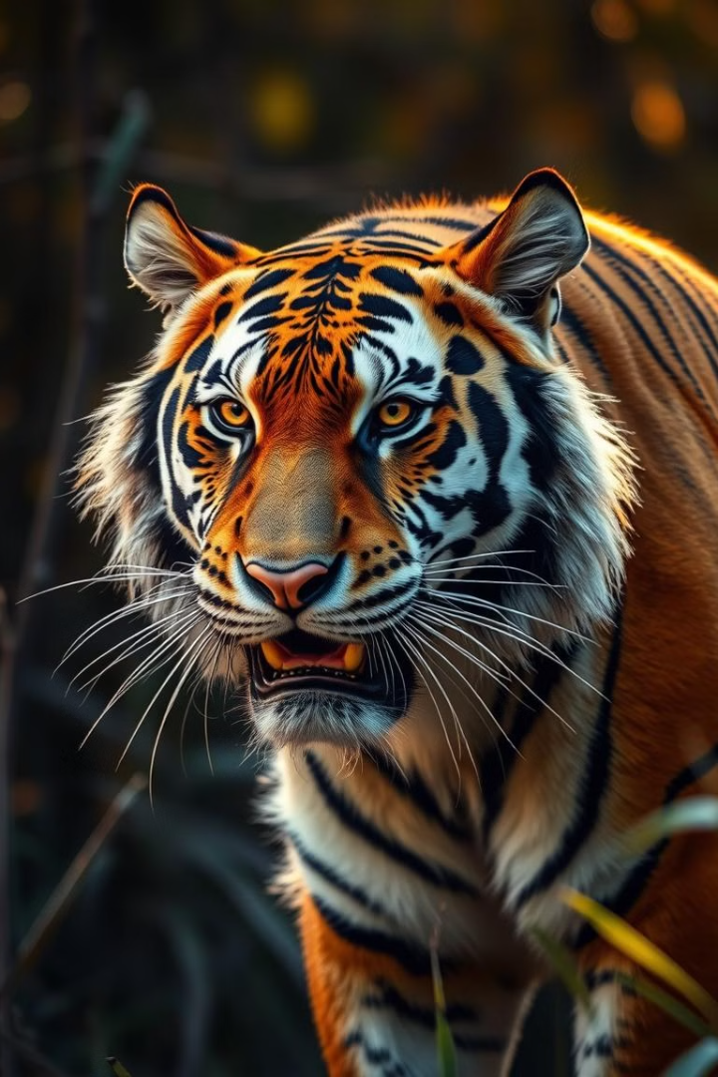




Protecting Endangered Species
Visvajeet R S
Aishwarya R
Arisha Begam T
Makilini

Slide 2

Brain Storming
1
Identify Threats
2
Explore Solutions
Brainstorm the key threats facing endangered species, such as deforestation, overhunting, pollution, and climate change.
Generate ideas for effective conservation strategies, including habitat restoration, anti-poaching measures, sustainable resource management, and public awareness campaigns.
3
Collaborate
4
Prioritize
Encourage cross-functional teamwork and engage with stakeholders, including policymakers, NGOs, and local communities, to develop a comprehensive action
Analyze the potential impact and feasibility of different ideas, and prioritize the most effective and impactful solutions.

Slide 3
Brain Storming
Habitat Loss
Climate Change
Poaching
Illegal Trade
Pollution
Invasive Species
Biodiversity Loss
Human Impact
Protected Areas
Captive Breedings
Reforestation
Habitat Restoration
Anti-Poaching Initiatives
Conservation
Deforestation
Biodiversity

Slide 4
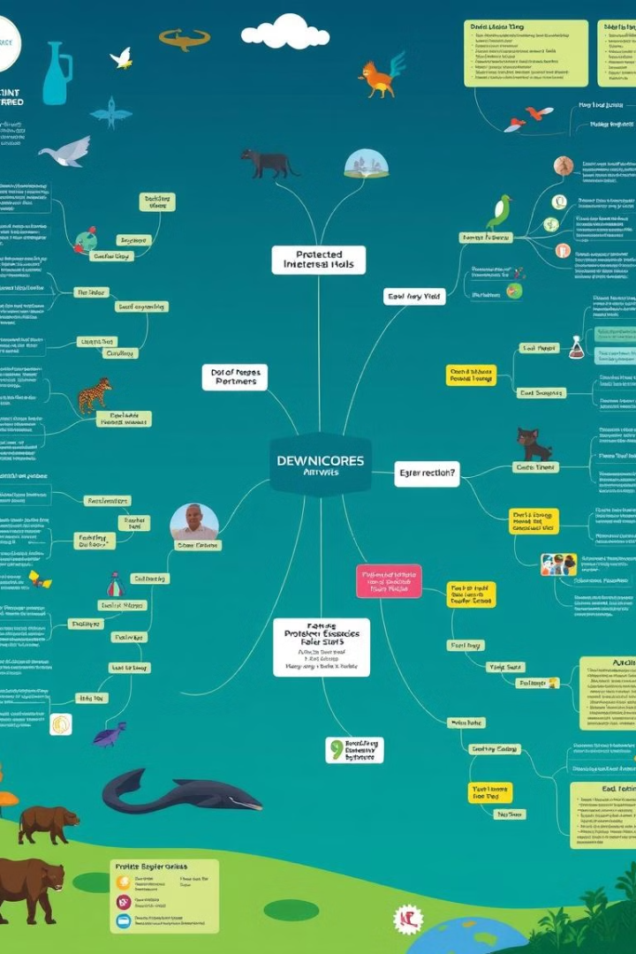
Mind Mapping
Identify Key Factors
1
Start by mapping out the core issues and drivers behind the endangerment of species, such as habitat loss, poaching, climate change, and human activities.
Explore Interconnections
2
Identify the relationships and interdependencies between different factors, highlighting how they influence each other and contribute to the overall problem.
Develop Strategies
3

Slide 5
5Ws + 1H
Who
What
When
Who are the endangered
Species
Who is responsible for the protection
Clearly define the objectives and goals of endangered species conservation, such as preventing extinction, restoring habitats, and promoting sustainable practices.
Establish a timeline for implementing conservation strategies, taking into account the urgent need for action and the long-term nature of ecosystem restoration.
Notes:
5

Slide 6
5Ws + 1H
Where
Why
How
Why is it important to protect endangered species? (e.g., ecological balance, biodiversity preservation, human well-being)
Why are certain species more vulnerable than others?
How can we protect endangered species? (e.g., habitat restoration, legislation, education, and awareness campaigns)
How can individuals contribute to this cause? (e.g., supporting wildlife organizations, reducing consumption of products linked to habitat destruction)
Where are these endangered species found? (e.g., forests, oceans, wetlands)
Where are conservation efforts most critical?
Notes:
6

Slide 7
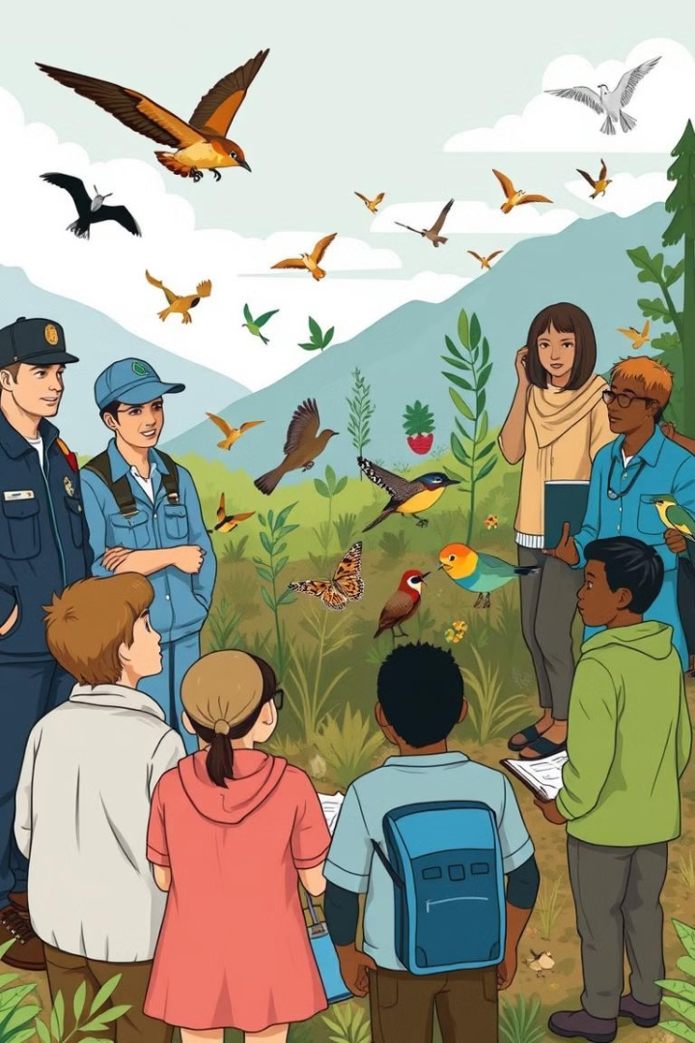




User Participant Mapping
Government Agencies
Scientists and Researchers
Policymakers, regulators, and enforcement authorities who can implement laws and regulations to protect endangered species.
Experts who study endangered species, their habitats, and the factors contributing to their decline.
Local Communities
Educators and Advocates
Individuals and groups who live in close proximity to endangered species and can play a role in conservation efforts.
Professionals who raise awareness, provide education, and engage the public in protecting endangered species.

Slide 8
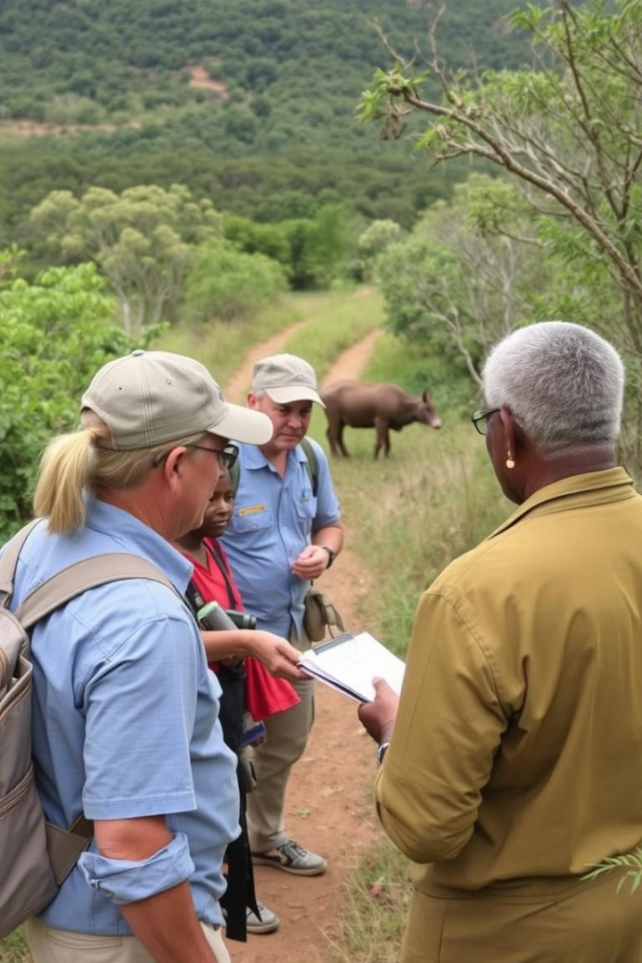
Contextual Inquiry
Observe Behaviors
Understand Challenges
Conduct field observations to understand how local communities interact with and perceive endangered species in their natural habitats.
Engage in open-ended interviews to identify the challenges and barriers faced by different stakeholders in protecting endangered species.
Identify Opportunities
Collaborative Solutions
Analyze the data collected to uncover opportunities for more effective conservation strategies that address the needs and concerns of all participants.
Work closely with stakeholders to co-create solutions that balance the interests of local communities, conservation efforts, and sustainable development.

Slide 9
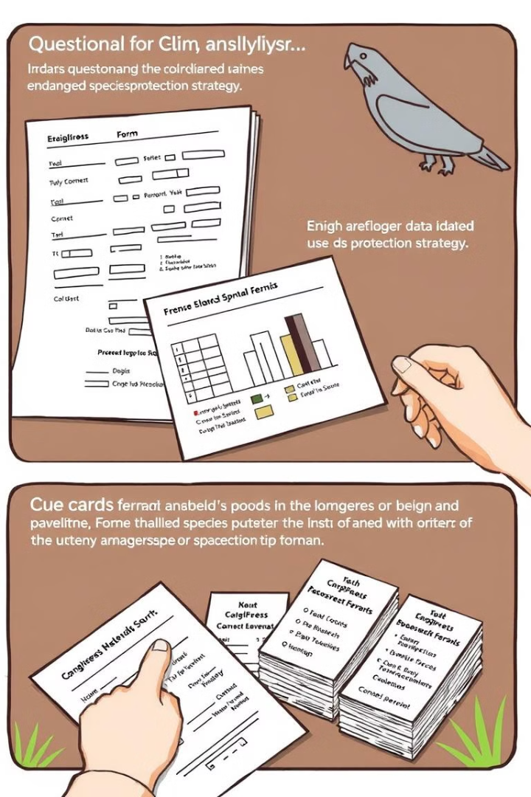



Questionnaires and Cue Cards
Awareness
How familiar are you with the term "endangered species"?
(a) Very familiar
(b) Somewhat familiar
(c) Not familiar
Have you heard of any endangered species in your local area?
Knowledge
Which of the following do you believe are the biggest threats to endangered species?
(a) Habitat loss
(b) Poaching
(c) Pollution
(d) Climate change
Create Cue Cards

Slide 10
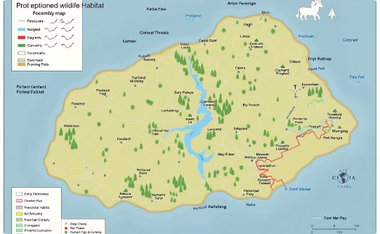
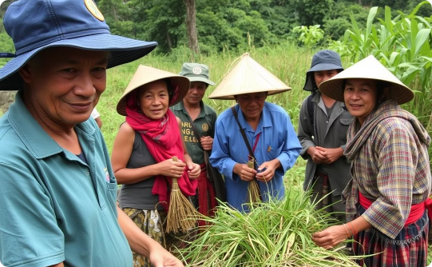
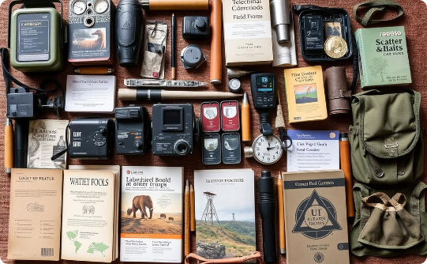
Artifact, Activity, and Spatial Mappings
Spatial Mapping
Activity Mapping
Artifact Mapping
Cameras and Drones:
Used for monitoring wildlife populations, tracking movements, and identifying threats like poaching.
Satellite Tracking Collars:
Attached to endangered animals for real-time tracking, migration pattern analysis, and health monitoring..
Catalog the various tools, technologies, and resources used by different stakeholders in endangered species protection, exploring how they can be better integrated and optimized.
Field Research and Monitoring:
Scientists and conservationists regularly conduct fieldwork to observe species in their natural habitats, recording population data, health indicators, and threats.

Slide 11
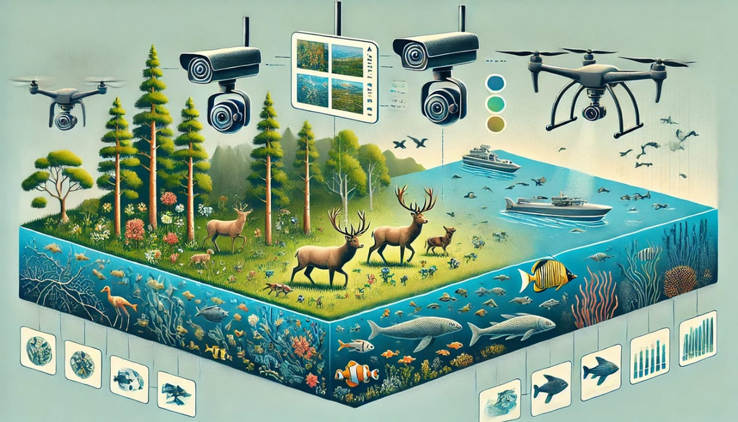
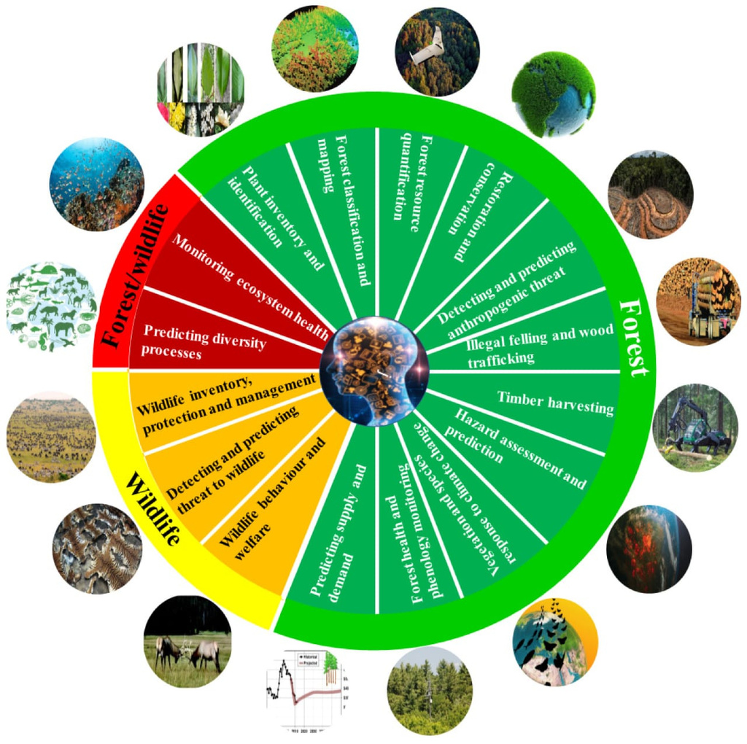
PROJECT MAPPING
Identify endangered species in specific regions
using AI.
Monitor populations through data collection
and analysis.
Predict threats to species using machine
learning models.
Educate the public about endangered species and
conservation efforts.

Slide 12
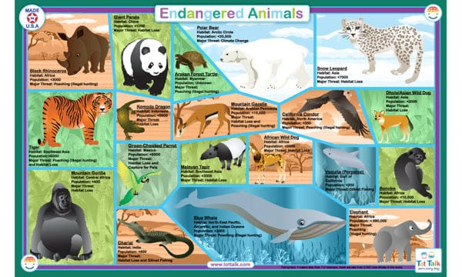

Sources: Gather data from wildlife databases, ecological studies, and satellite imagery.
Image Recognition: Use computer vision to identify species in images from camera traps or drones.
Predictive Analytics: Develop models to predict population trends and threats based on historical data.
Natural Language Processing: Analyze social media and news articles to track public sentiment and awareness.

Slide 13
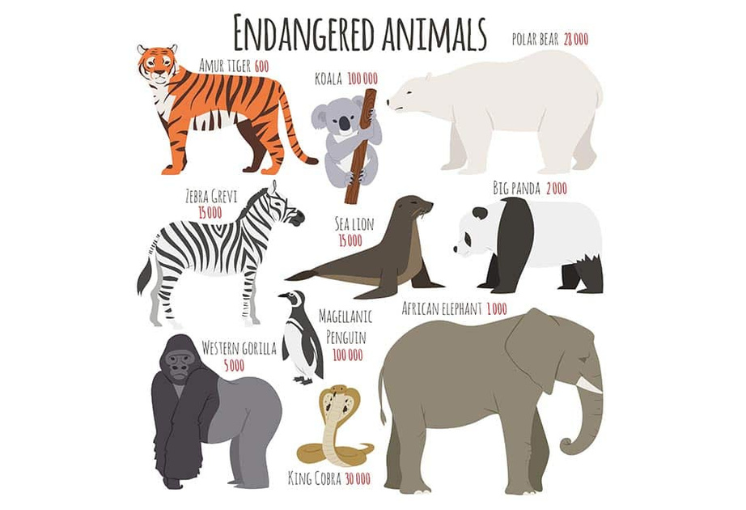
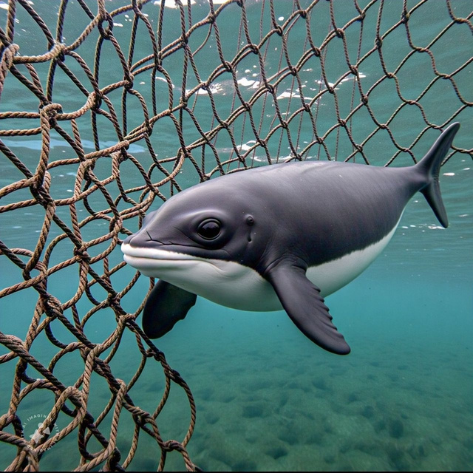
PERSONA’S
he Conservation Scientist
Name: Dr. Emily Carter
Age: 38
Occupation: Ecologist
Background: Holds a Ph.D. in Environmental Science; specializes in wildlife conservation.
Goals: Conduct research on endangered species; publish findings; influence conservation policy.
Motivations: Passion for biodiversity; desire to protect ecosystems for future generations.
Challenges: Limited funding for research; difficulty accessing data.
The Local Community Member
Name: Carlos Rodriguez
Age: 45
Occupation: Farmer
Background: Lives near a protected area; has traditional ecological knowledge.
Goals: Sustainable farming practices; community well-being; preserve local wildlife.
Motivations: Concern for the environment; interest in preserving family land; community health.
Challenges: Economic pressures; potential conflicts with conservation regulations.

Slide 14
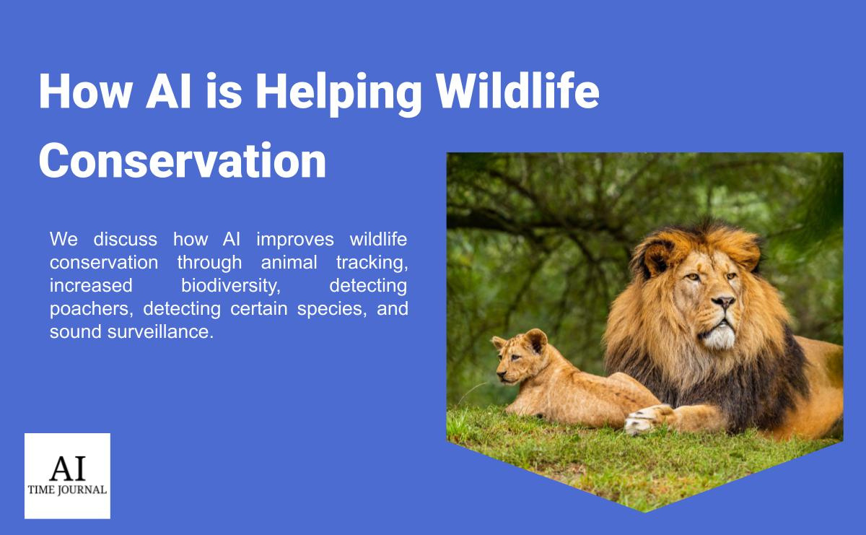


Slide 15
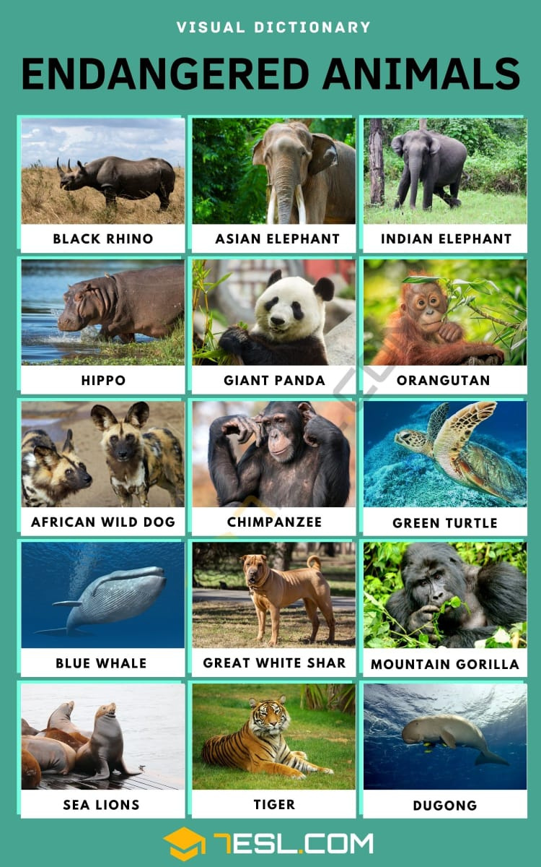
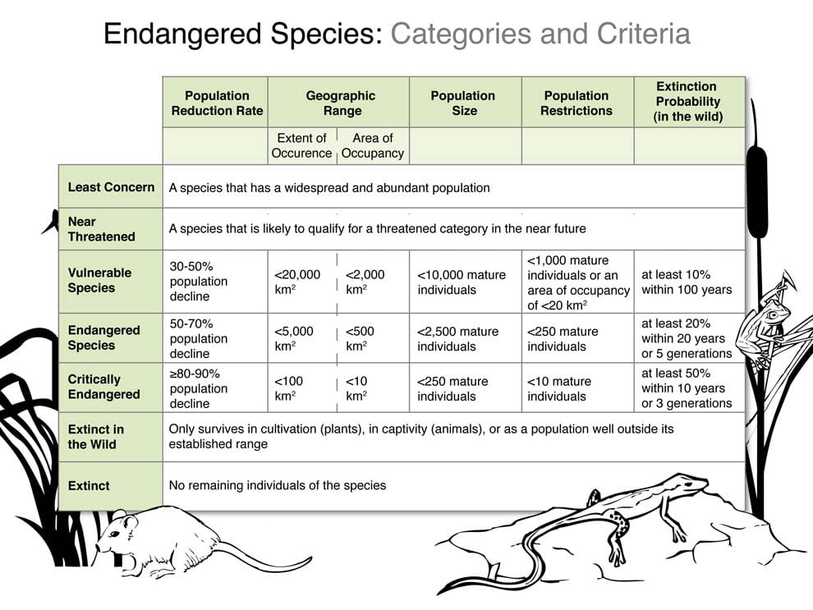
OIOR TABLE

Slide 16
Analysis
Identify Patterns
Evaluate Effectiveness
Prioritize Interventions
Carefully examine the data and insights gathered during the previous stages, looking for recurring themes, pain points, and opportunities that can inform the development of a comprehensive endangered species protection strategy.
Assess the potential impact and feasibility of different conservation approaches, considering factors such as cost, scalability, environmental impact, and stakeholder engagement.
Based on the analysis, identify the most critical and impactful interventions to focus on, taking into account the urgency of the situation and the available resources and capabilities.

Slide 17
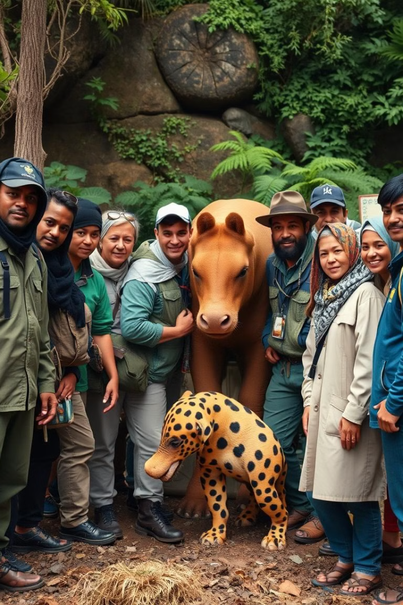



Conclusion and Call to Action
Comprehensive Strategy
Synthesize the insights and recommendations gathered throughout the design thinking process into a cohesive, multi-pronged strategy for protecting endangered species, addressing the needs and concerns of all stakeholders.
Collaborative Approach
Emphasize the importance of cross-functional collaboration, interdisciplinary cooperation, and community engagement in the successful implementation of endangered species conservation efforts.
Call to Action
Inspire and empower all stakeholders, from policymakers to individual citizens, to take immediate and sustained action to protect endangered species and their habitats, ensuring a brighter future for our planet's biodiversity.

Slide 18
THANK
YOU

